Slide 1
Devops

Slide 2
Devops
DevOps is a combination of software development (dev) and operations (ops). It is defined as a software engineering methodology which aims to integrate the work of development teams and operations teams by facilitating a culture of collaboration and shared responsibility.

Slide 3
Different Phases of the DevOps lifecycle

Slide 4
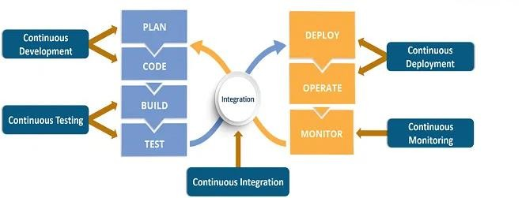
DevOps Lifecycle Diagram

Slide 5
Plan
Activities: Define project requirements, prioritize tasks, and plan the development and deployment process.
Tools: Project management tools like Jira, Trello, or Azure Boards for task tracking and collaboration. Additionally, tools like Confluence or Google Docs for documentation and communication.

Slide 6
Code
Activities: Developers write code, collaborate on the codebase, and ensure code quality through practices like code reviews and pair programming.
Tools: Version control systems like Git for code repository management and collaboration. Code review tools like Bitbucket, GitHub, or GitLab for reviewing and managing code changes.

Slide 7
Build
Activities: Automatically build and integrate code changes, compile code, and generate artifacts.
Tools: Continuous Integration (CI) tools like Jenkins, CircleCI, or Azure DevOps Pipelines for automated builds and integration. Build tools like Maven, Gradle, or Ant for managing dependencies and compiling code.

Slide 8
Test
Activities: Execute various types of automated tests (unit tests, integration tests, performance tests, etc.) to ensure code quality and identify bugs.
Tools: Testing frameworks like Selenium, JUnit, or pytest for automated testing. Test management tools like TestRail or Zephyr for test case management. Code coverage tools like JaCoCo or Cobertura for measuring code coverage.

Slide 9
Deploy
Activities: Package the application and its dependencies, configure the deployment environment, and deploy the application to the target environment.
Tools: Deployment automation tools like Ansible, Puppet, or Chef for configuring and provisioning infrastructure. Containerization tools like Docker or Kubernetes for container-based deployments. Continuous Deployment (CD) tools like Jenkins, GitLab CI/CD, or AWS CodeDeploy for automating the deployment process.

Slide 10
Operate
Activities: Monitor the application and infrastructure, detect and resolve issues, and ensure high availability and performance.
Tools: Monitoring and alerting tools like Prometheus, Grafana, Nagios, or Datadog for collecting and visualizing metrics. Log management tools like ELK Stack (Elasticsearch, Logstash, Kibana) or Splunk for collecting and analyzing logs. Infrastructure management tools like Terraform or AWS CloudFormation for managing infrastructure resources.

Slide 11
Monitor
Activities: Analyze metrics, logs, and user feedback to gain insights into the application's behavior, identify performance bottlenecks, and detect anomalies.
Tools: Monitoring and observability tools mentioned earlier (e.g., Prometheus, Grafana, ELK Stack) for analyzing metrics and logs. User feedback tools like Zendesk or Intercom for gathering feedback and support.

